Slide 1


WSO2 API MANAGEMENT
Created By : Berca Team

Slide 2
Introduction

Slide 3
Introducing the API Manager
You can grow your business faster and scalable by using a decentralized API.
However, using APIs in a collaborative way introduces new challenges in exercising control, establishing trust, security and regulation. As a result, proper API management is crucial.

Slide 4
About WSO2 API Manager
What is WSO2 API Manager?
WSO2 API Manager is a platform for creating, managing, consuming and monitoring APIs. It employs proven SOA (Service Oriented Architecture) best practices to solve a wide range of API management challenges such as API provisioning, API governance, API security and API monitoring.
What are the technologies used underneath WSO2 API Manager?
The API Manager is built on top of WSO2 Carbon, an OSGi based components framework for SOA.
What is the default communication protocol of the API Manager?
The default communication protocol is Thrift.

Slide 5

Key Concepts

Slide 6
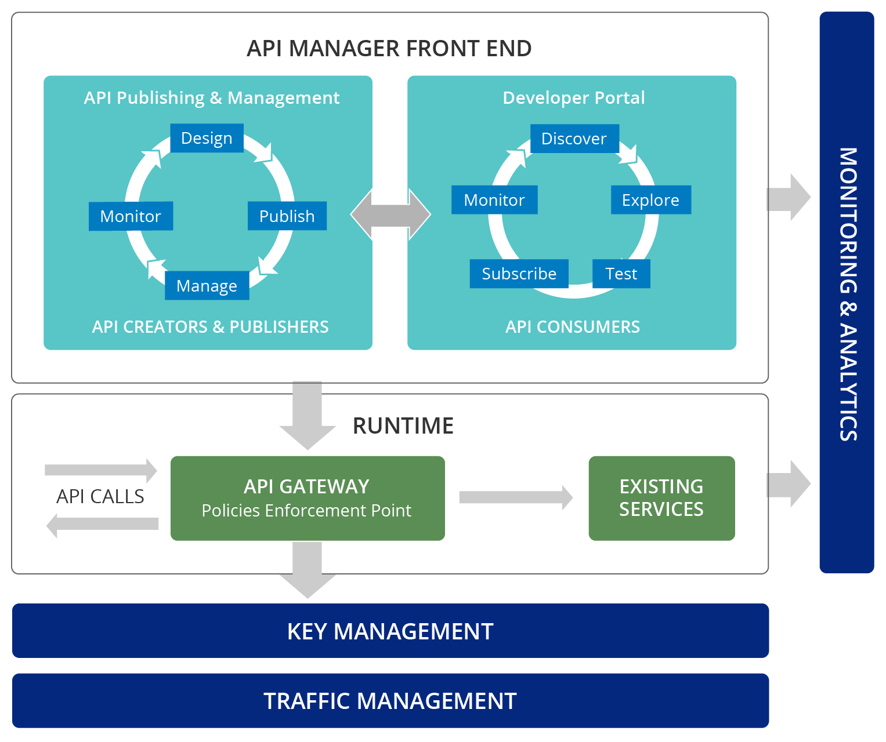
API Manager components

Slide 7
Users and roles
The API manager offers three distinct community roles that are applicable to most enterprises:
Creator: A creator is a person in a technical role who understands the technical aspects of the API (interfaces, documentation, versions, how it is exposed by the Gateway, etc.) and uses the API publisher to provision APIs into the API Store. The creator uses the API Store to consult ratings and feedback provided by API users. Creators can add APIs to the store but cannot manage their life cycle (e.g., make them visible to the outside world.)
Publisher: A publisher manages a set of APIs across the enterprise or business unit and controls the API life cycle and monetization aspects.
Consumer: A consumer uses the API Store to discover APIs, see the documentation and forums, and rate/comment on the APIs. Consumers subscribe to APIs to obtain API keys.

Slide 8
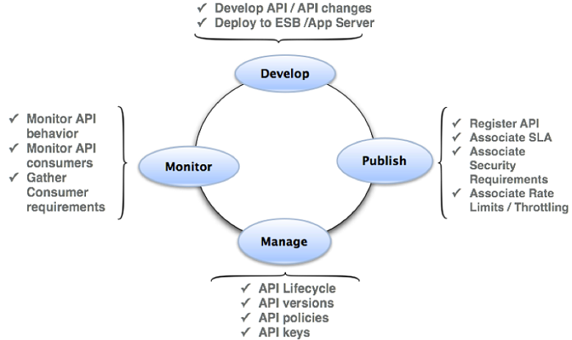
API Publisher
Enables API providers to publish APIs, share documentation, provision API keys and gather feedback on features, quality and usage. You access the Web interface via
https://<Server Host>:9443/publisher.

Slide 9
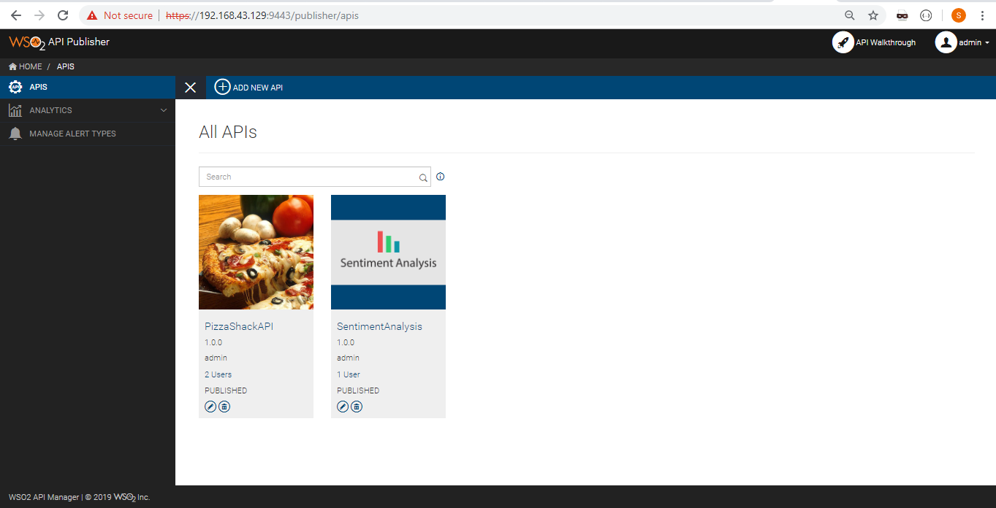
API Publisher Web Interface

Slide 10
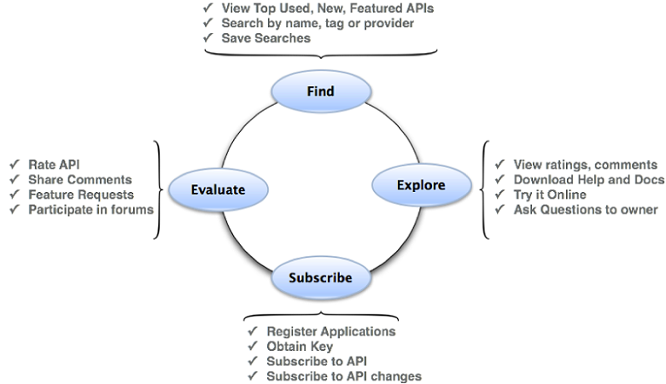
API Store (Developer Portal)
Enables API consumers to self register, discover and subscribe to APIs, evaluate them and interact with API Publishers. You access the Web interface via https://<Server Host>:9443/store.

Slide 11
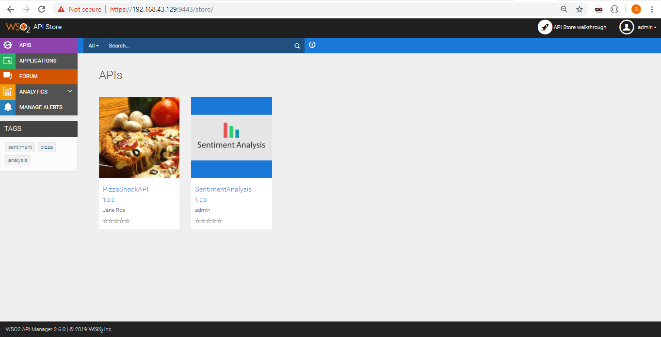
API Store Web Interface

Slide 12
API Gateway
Secures, protects, manages, and scales API calls. It is a simple API proxy that intercepts API requests and applies policies such as throttling and security checks. It is also instrumental in gathering API usage statistics. The Web interface can be accessed via https://<Server Host>:9443/carbon.

Slide 13
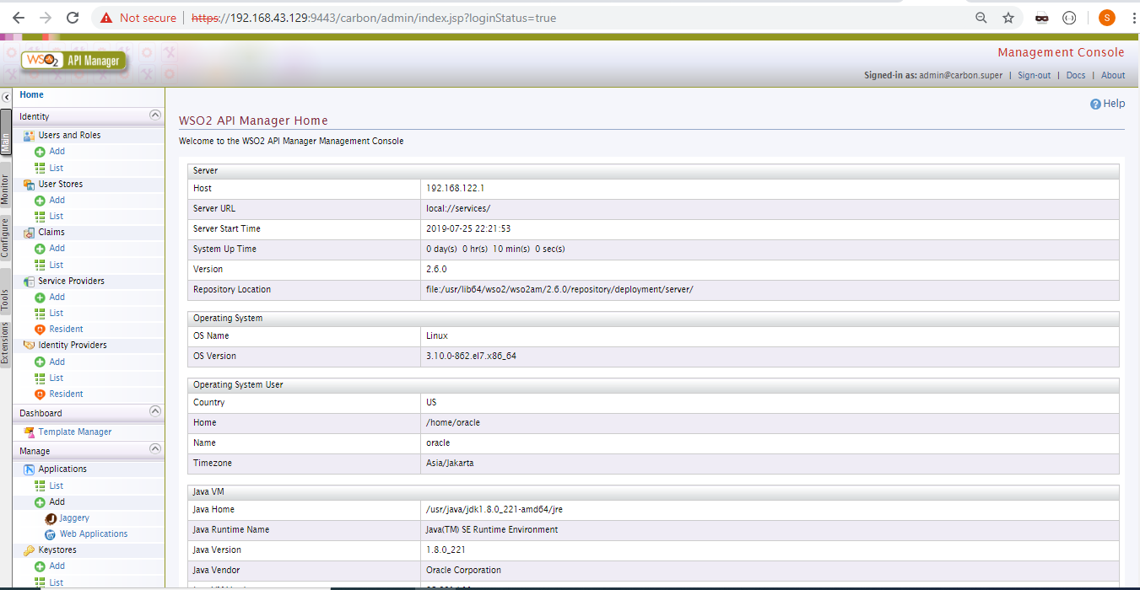
API Gateway Web Interface

Slide 14
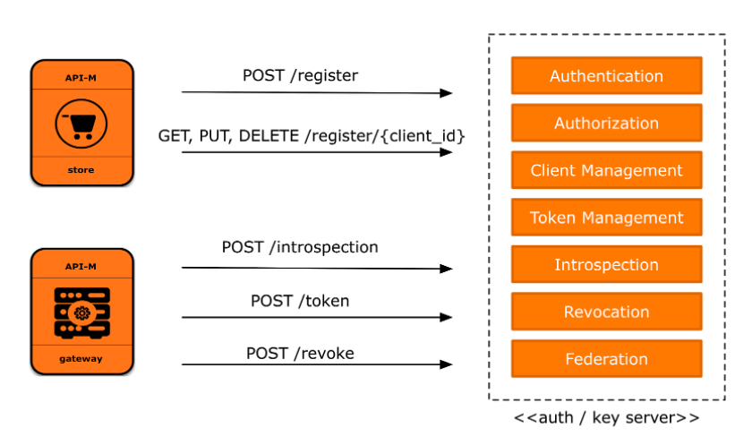
Key Manager
Handles all security and key-related operations. The API Gateway connects with the Key Manager to check the validity of subscriptions, OAuth tokens, and API invocations. The Key Manager also provides a token API to generate OAuth tokens that can be accessed via the Gateway.

Slide 15
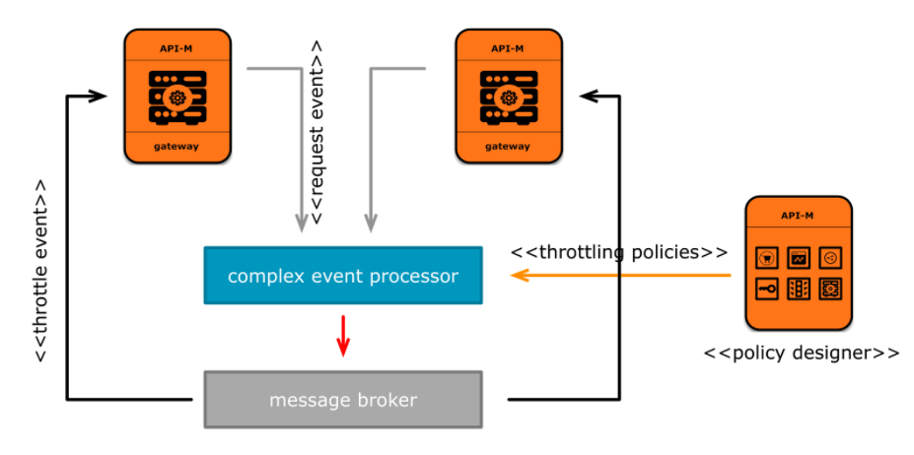
Traffic Manager
Helps users to regulate API traffic, make APIs and applications available to consumers at different service levels and secures APIs against security attacks. The Traffic Manager features a dynamic throttling engine to process throttling policies in real-time.

Slide 16
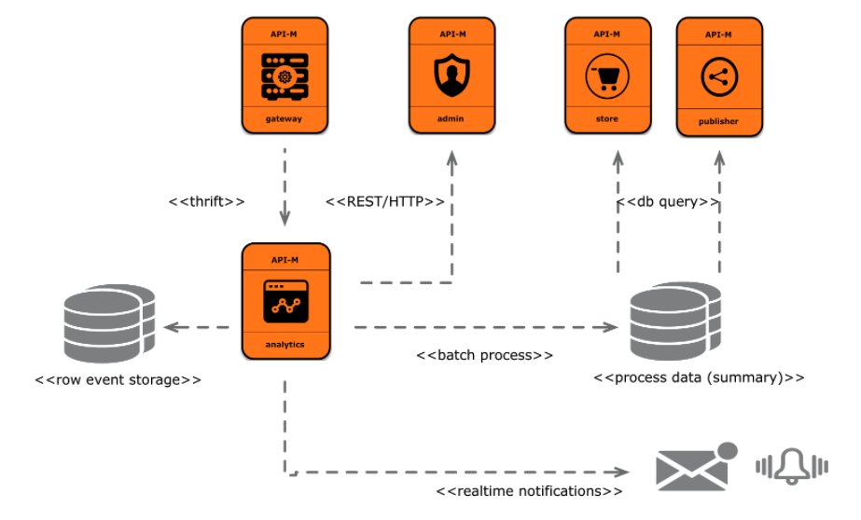
WSO2 API Manager Analytics
Provides a host of statistical graphs and an alerting mechanism on predetermined events.

Slide 17
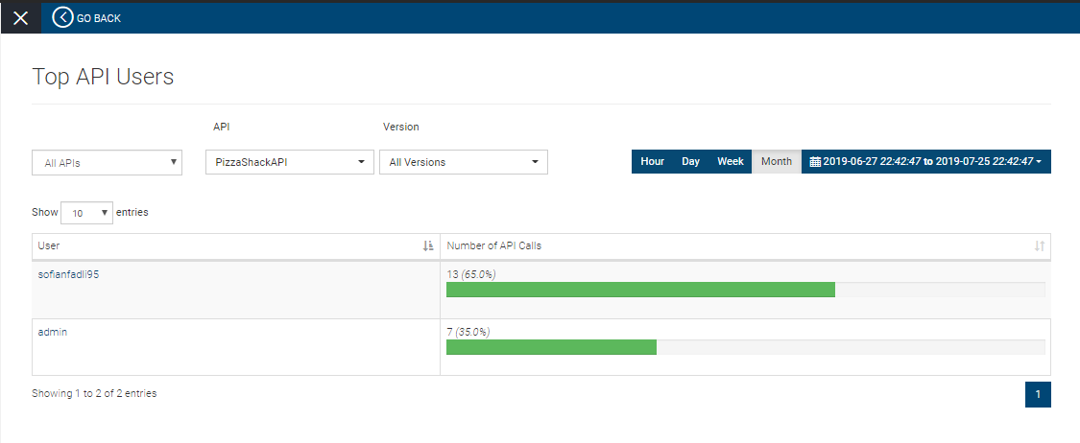
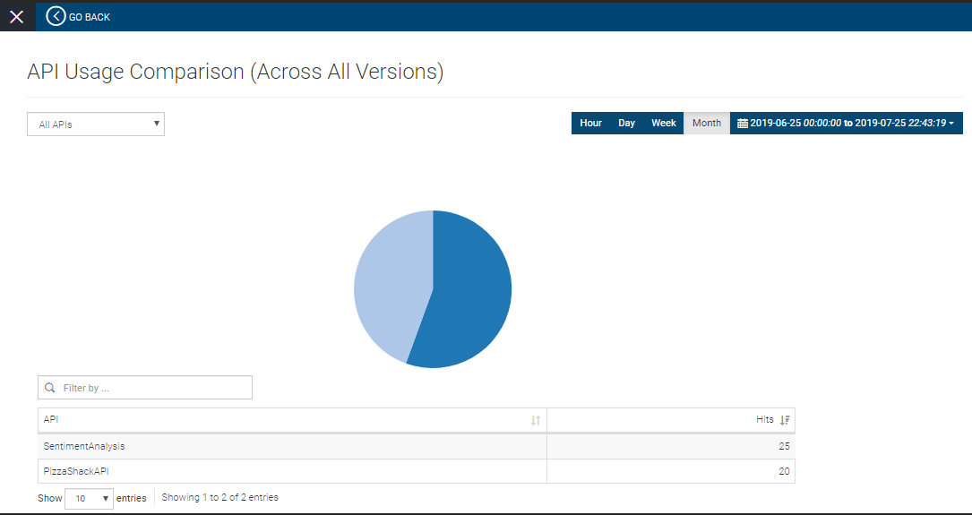
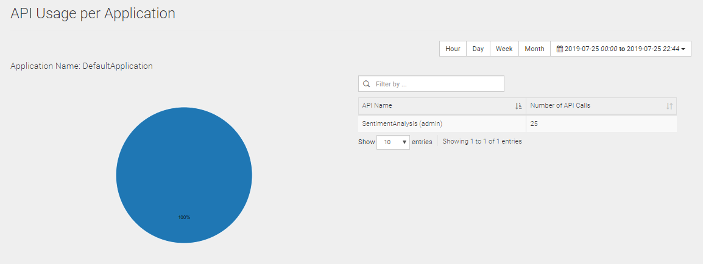
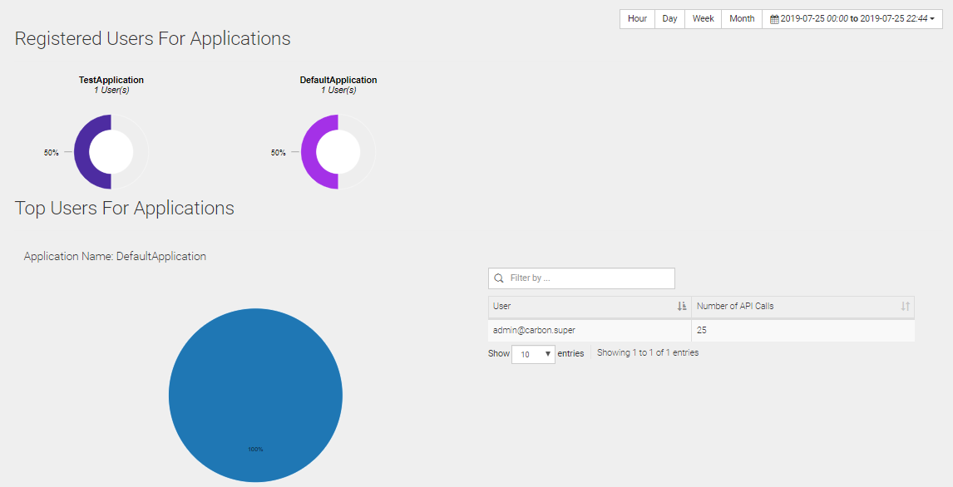
Some Analytics features on WSO2

Slide 18
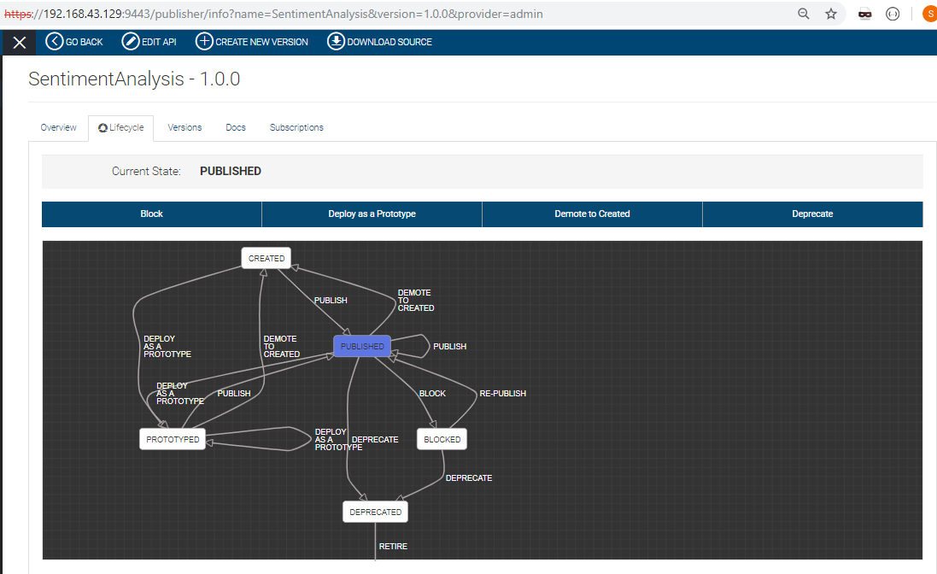
API lifecycle

Slide 19
API lifecycle
The following stages are available in the default API lifecycle:
CREATED: API metadata is added to the API Store, but it is not deployed in the API Gateway and therefore, is not visible to subscribers in the API Store.
PROTOTYPED: The API is deployed and published in the API Store as a prototype. A prototyped API is usually a mock implementation made public in order to get feedback about its usability. Users can invoke the API without a subscription.
PUBLISHED: The API is visible in the API Store and available for subscription.
DEPRECATED: When an API is deprecated, new subscriptions are disabled. But the API is still deployed in the Gateway and is available at runtime to existing subscribers. Existing subscribers can continue to use it as usual until the API is retired.
RETIRED: The API is unpublished from the API Gateway and deleted from the store.
BLOCKED: Access to the API is temporarily blocked. Runtime calls are blocked and the API is not shown in the API Store anymore.

Slide 20
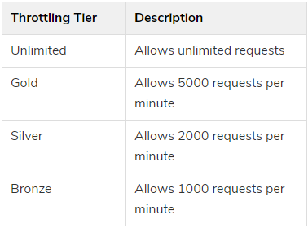
Throttling tiers
Throttling tiers are associated with an API at subscription time and can be defined at an API-level, resource-level, subscription-level and application-level (per token). They define the throttling limits enforced by the API Gateway, e.g., 10 TPS (transactions per second).

Slide 21
Demo WSO2 API Manager (API Sentiment & Entity Analysis)

Slide 22
Start the WSO2 API Management services
Start the WSO2 API M service :
wso2am-2.6.0
Start the Analytics Server :
cd /home/oracle/wso2am-analytics/bin
sh worker.sh

Slide 23
Start API Sentiment & Entity Analysis
Activate the sentiment API :
cd /var/www/html/items-rest/
/home/hadoop/anaconda3/bin/python pretrained-server- maybank.py

Slide 24
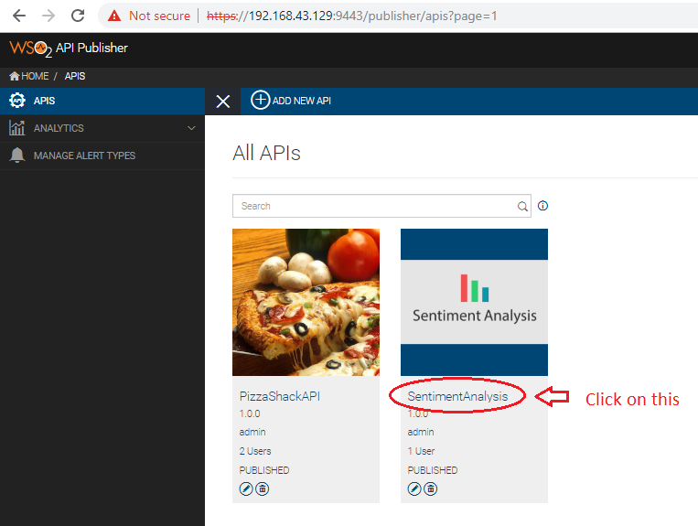
Open the publisher web portal

Slide 25
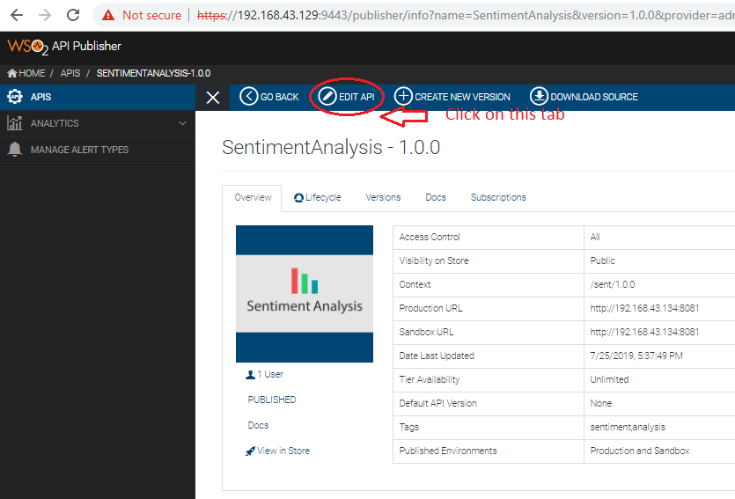
Edit and configure the API

Slide 26
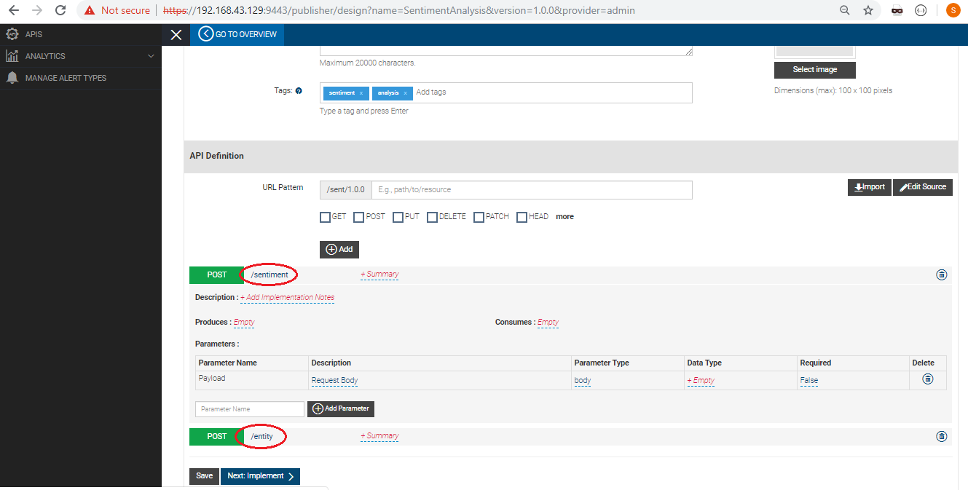
Setting the endpoints and HTTP Method

Slide 27
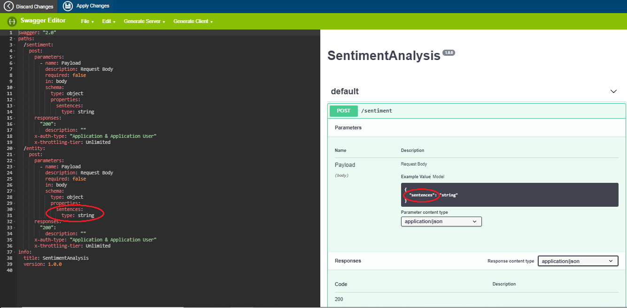
Setting parameters for API body

Slide 28
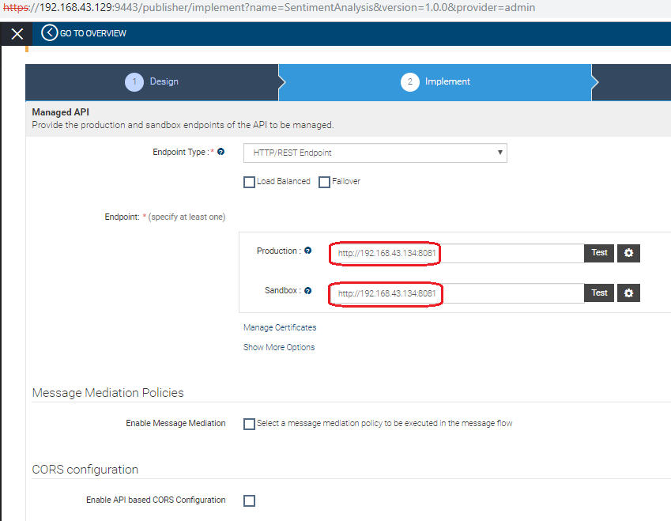
Setting the URL’s endpoint

Slide 29
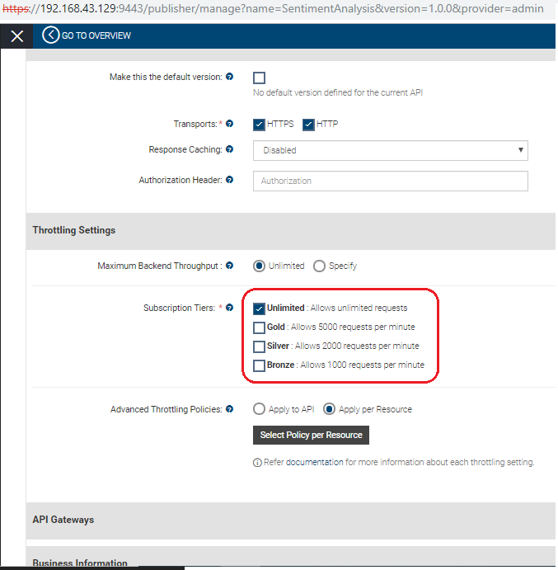
Choose Subscriptions Tiers

Slide 30
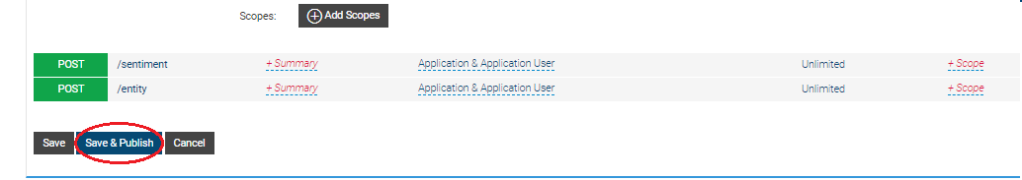
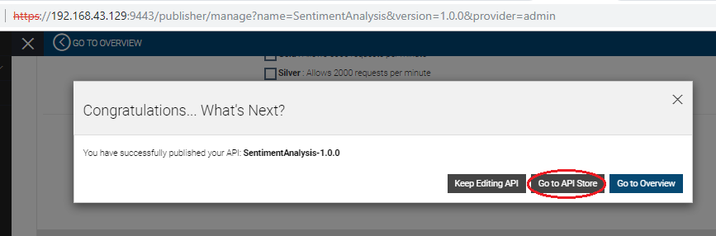
Save & Publish Your API

Slide 31
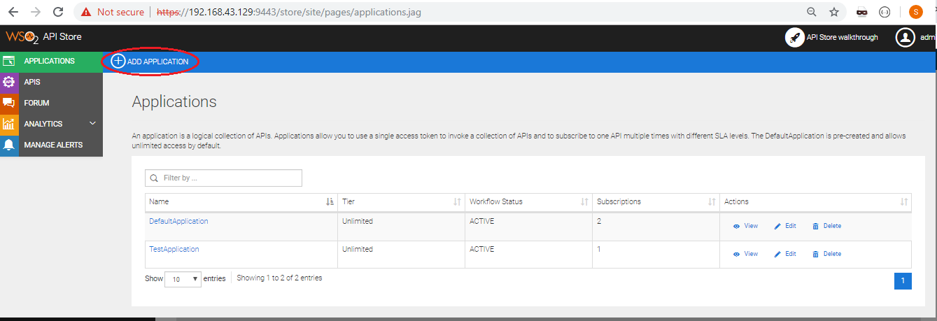
Go to the Web Store

Slide 32
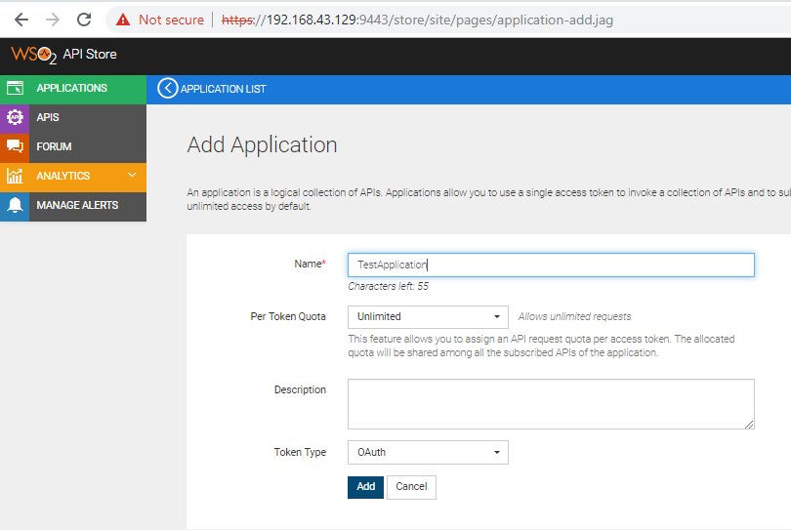
Giving the name for Your Application

Slide 33
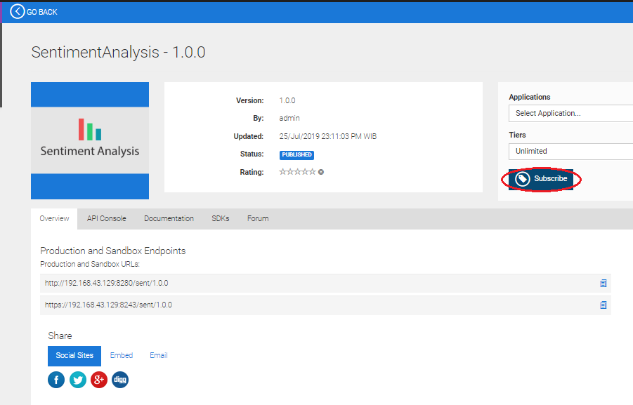
Subscribe the API

Slide 34
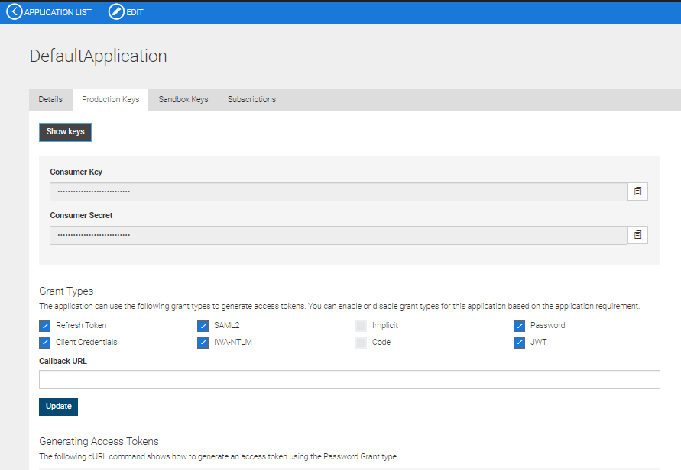
Generate Token for using API

Slide 35
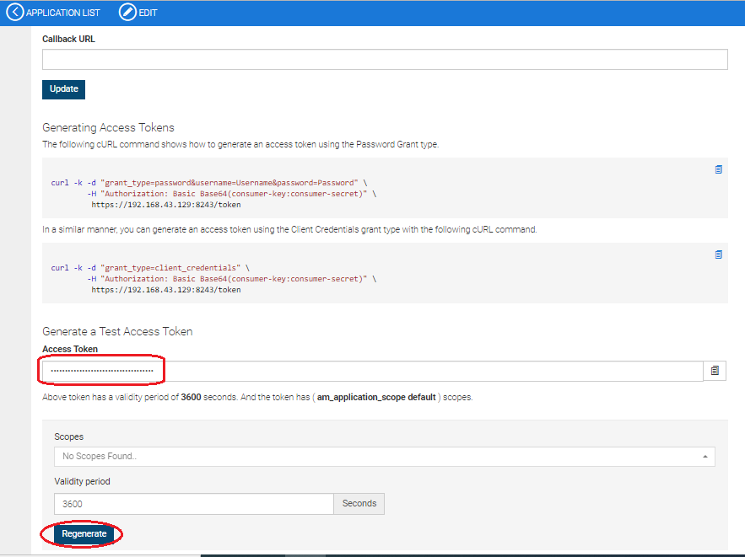
Generate Access Token for using API

Slide 36
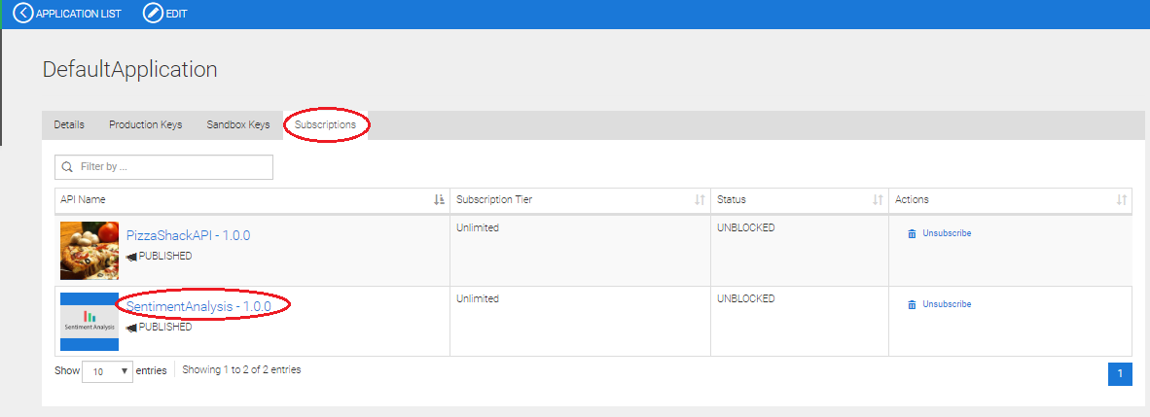
Get to the API’s link on the Subscriptions tab

Slide 37
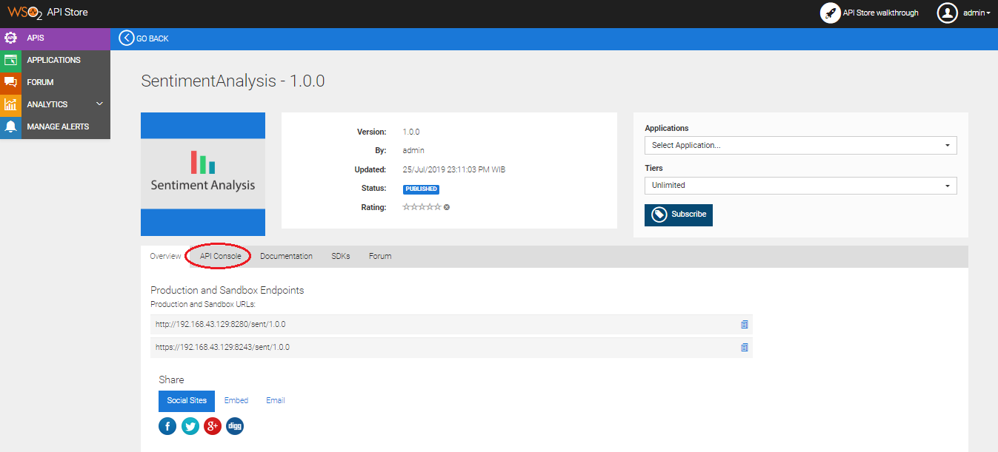
Change the tab to the ‘API Console’

Slide 38
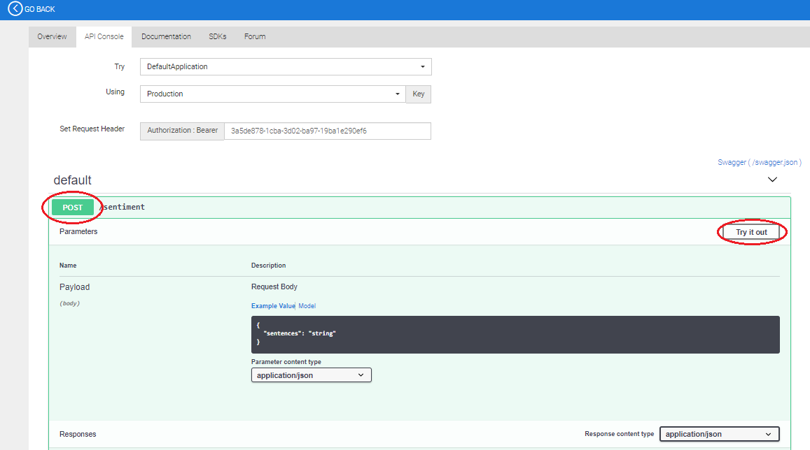
Click ‘Post’ and click ‘Try It Out’

Slide 39
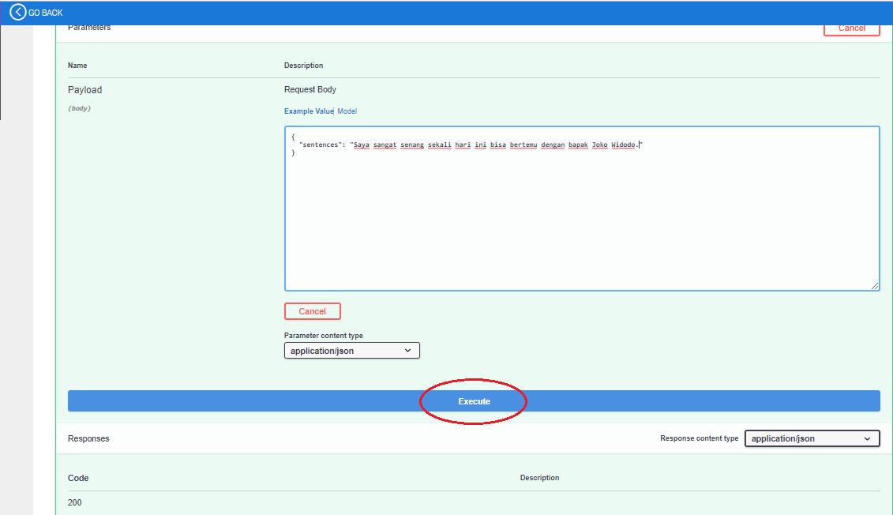
Create the sentences and click ‘Execute’

Slide 40
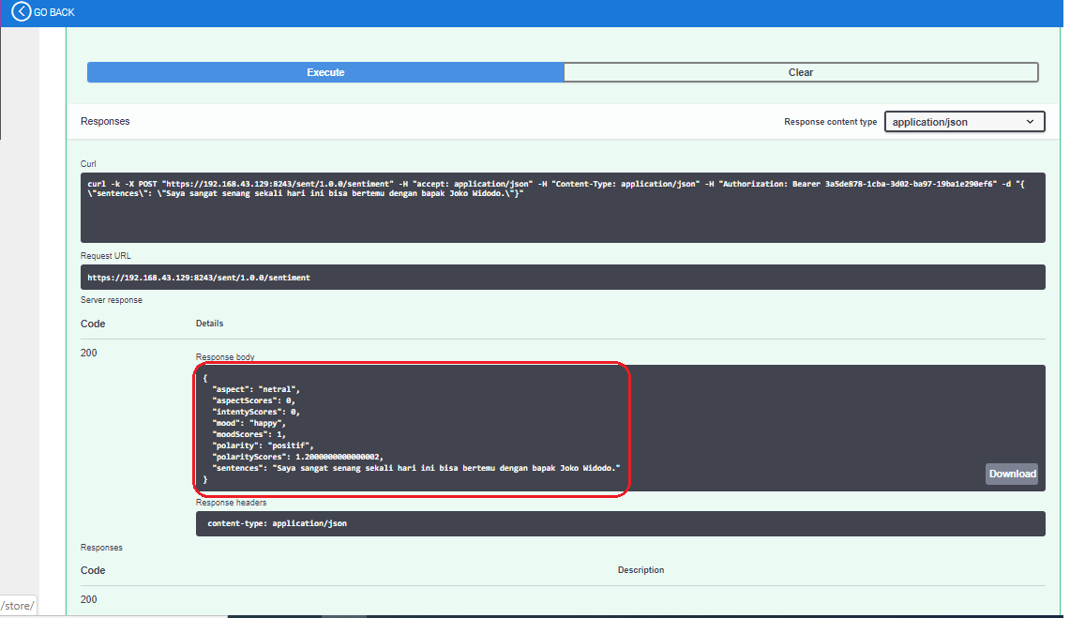
Get the result back from the API

Slide 41
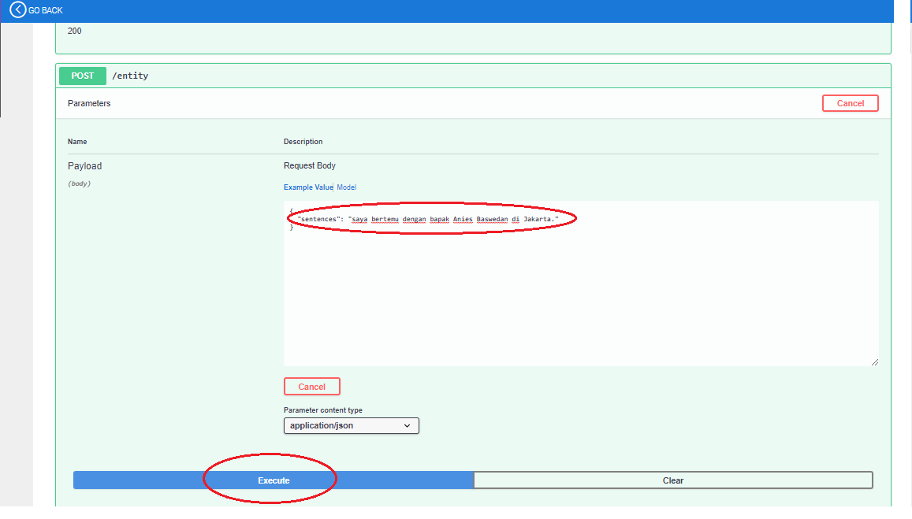
Testing for the /entity endpoint too

Slide 42
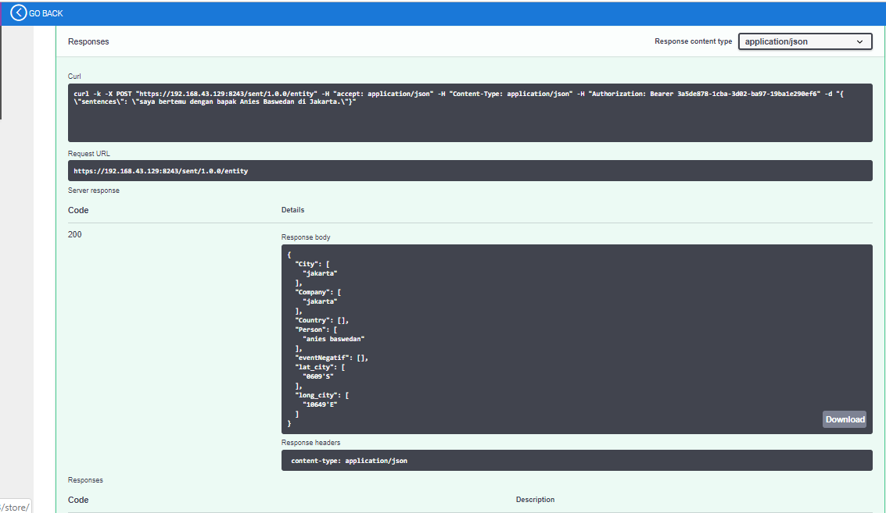
Get the result back from /entity endpoint

Slide 43
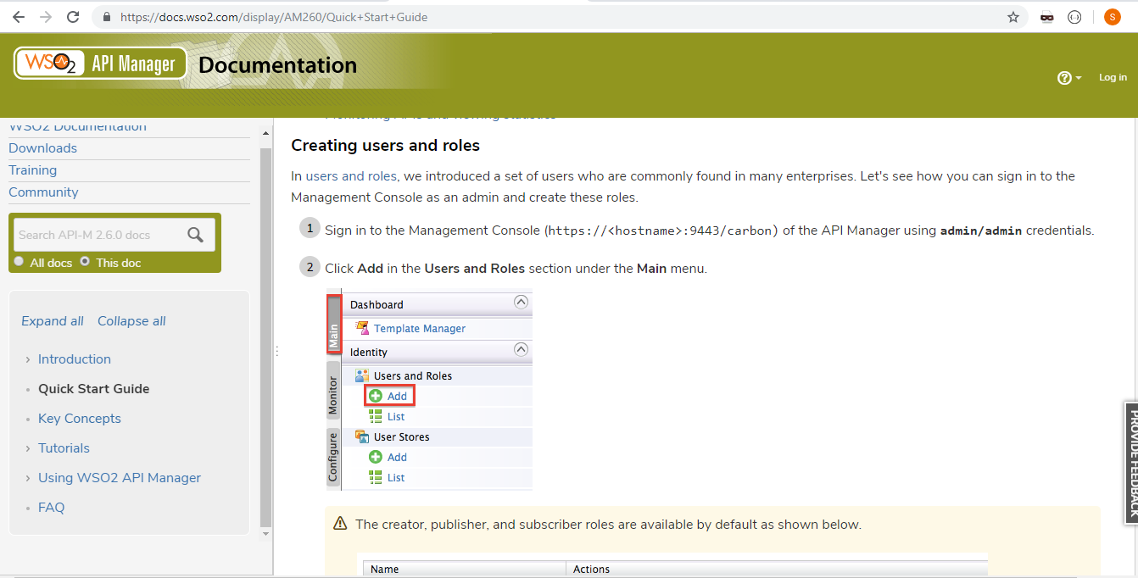
More Documentations
https://docs.wso2.com/display/AM260/Quick+Start+Guide

Slide 44
SEKIAN
DAN
TERIMA KASIH ☺

